Slide 1
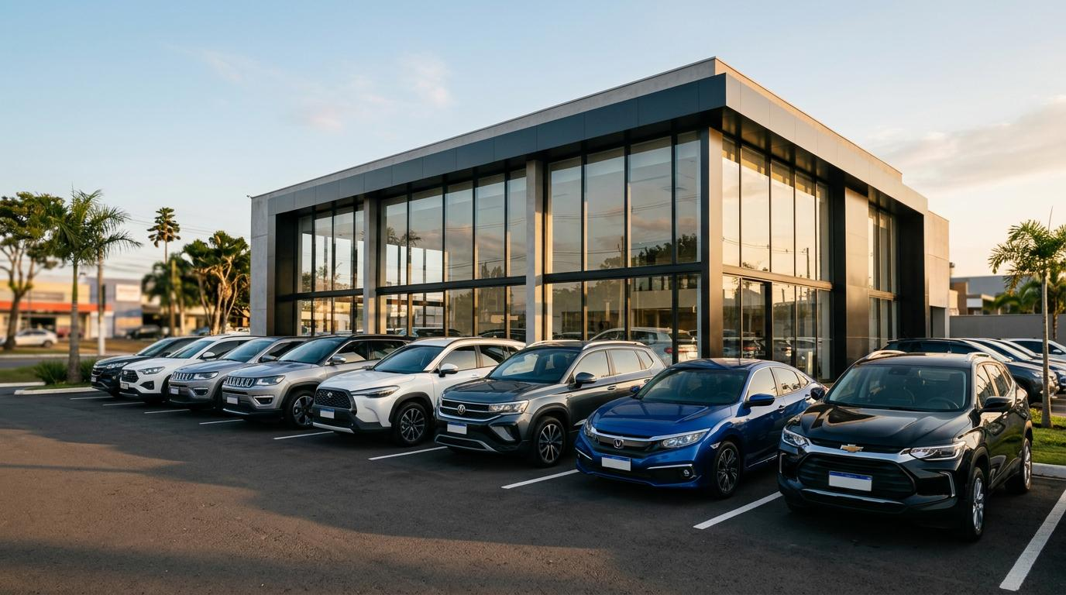
CMSE 830 • MIDTERM PROJECT
Project: Used-Car Price
What factors are associated with used-car prices?
An interactive data exploration app for people shopping for a used car
Presenter: Masoud Moradi Date: 10/15/2026

Slide 2
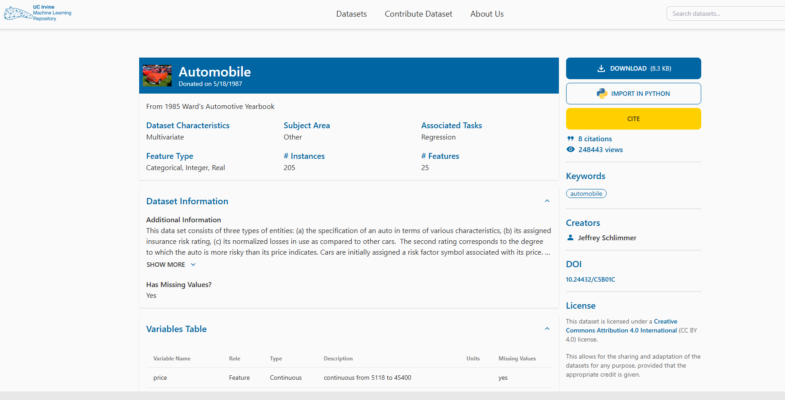
01 • PROBLEM, AUDIENCE & DATA
Helping buyers explore price differences
1. Target Audience
2. Questions
3. Candidate dataset
People who are considering buying a used car and want to compare vehicle characteristics.
• Does horsepower relate to price?
• Do larger engines tend to cost more?
• How do prices differ by manufacturer?
UCI Automobile dataset
- 205 observations
- 25 variables
One row represents one automobile
Source: UCI Machine Learning Repository — https://uci-ics-mlr-prod.aws.uci.edu/dataset/10/automobile
CMSE 830 • Midterm Project
2

Slide 3
02 • DATA PREPARATION
Making the data ready to explore (Initial Data Analysis)
1. Numerical variables
2. Categorical variables
3 .Quality checks
Price
Horsepower
Engine size
Curb weight, MPG, length and width
Use numeric summaries and distributions.
Manufacturer (make)
Body style
Fuel type
Drive wheels
Check category spelling and group sizes; encode if a model requires it.
Inspect data types and dimensions
Count missing values in price and horsepower
Check unusual values and duplicates
Confirm how dropped rows affect results
CMSE 830 • Midterm Project
3

Slide 4
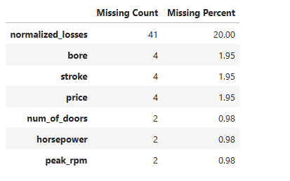
02 • DATA PREPARATION
The source uses “?” for unavailable values; these were converted to missing values (NaN).
No exact duplicate rows
The duplicate check found 0 duplicates.
Price has 4 missing values (1.95%)
Horsepower has 2 missing values (0.98%).
normalized_losses has 41 missing values (20.00%).
Number of missing values
4

Slide 5
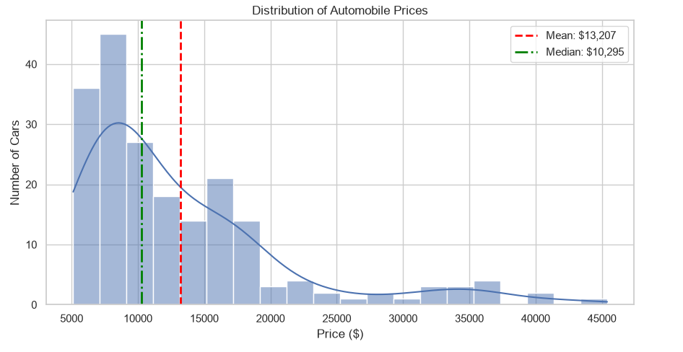
03 • EDA VISUALIZATION
Vehicle prices are right-skewed.
With a mean = $13,207.
With a median = $10,295.
CMSE 830 • Midterm Project
5

Slide 6
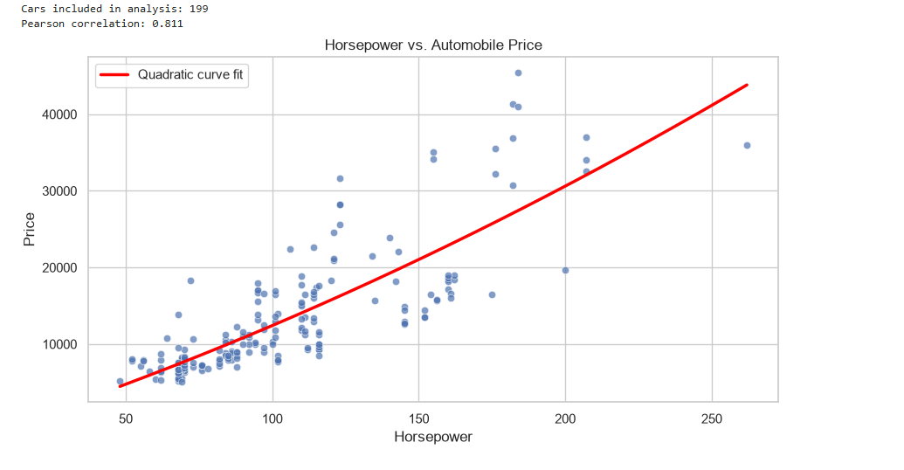
03 • EDA VISUALIZATION
Question 1: Is horsepower related to price?
Horsepower has a strong positive relationship with car prices (correlation = 0.811).
Other factors, such as brand, engine size, and features, can also affect prices.
Horsepower helps predict car prices, but correlation does not imply causation.
CMSE 830 • Midterm Project
6

Slide 7
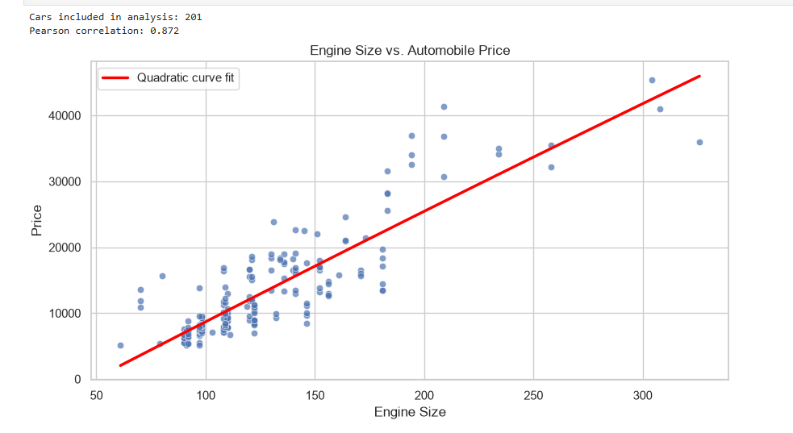
03 • EDA VISUALIZATION
Relationship Between Engine Size and Price
Engine size has a strong positive correlation with car prices (r = 0.872).
Larger engines tend to cost more; again, other factors also influence vehicle prices.
7

Slide 8
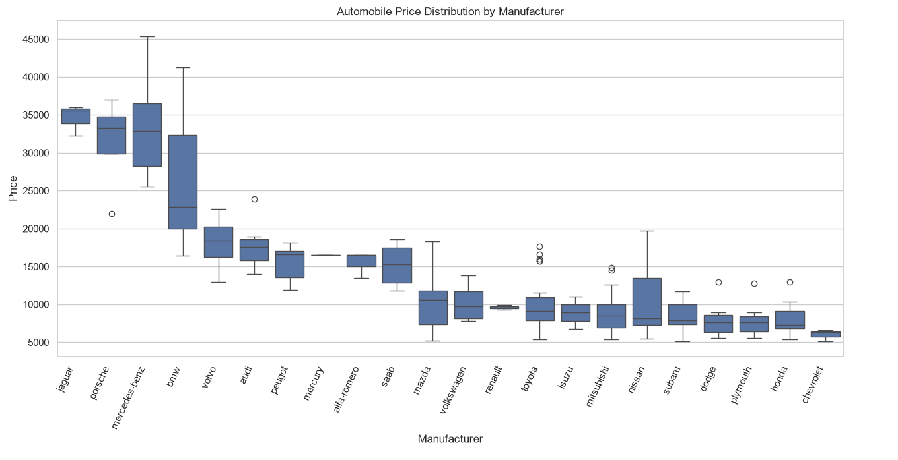
03 • EDA VISUALIZATION
Question 2: How do prices differ by manufacturer?
Jaguar, Porsche, Mercedes-Benz, and BMW have higher median prices.
Chevrolet, Honda, Dodge, and Plymouth generally have lower median prices.
while
CMSE 830 • Midterm Project
8

Slide 9
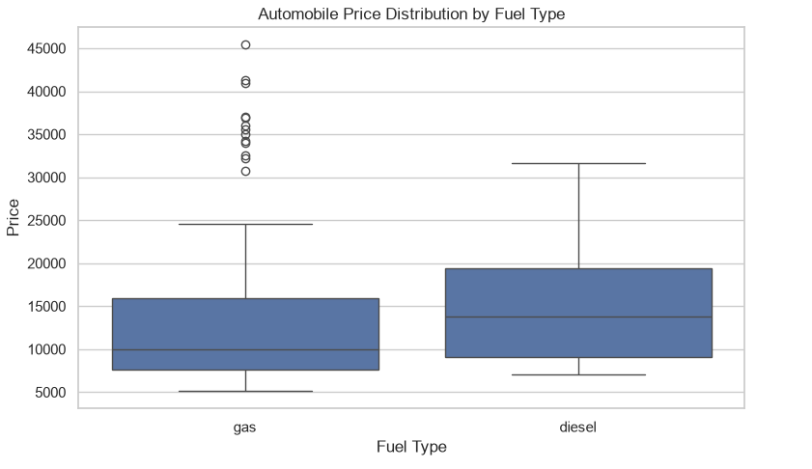
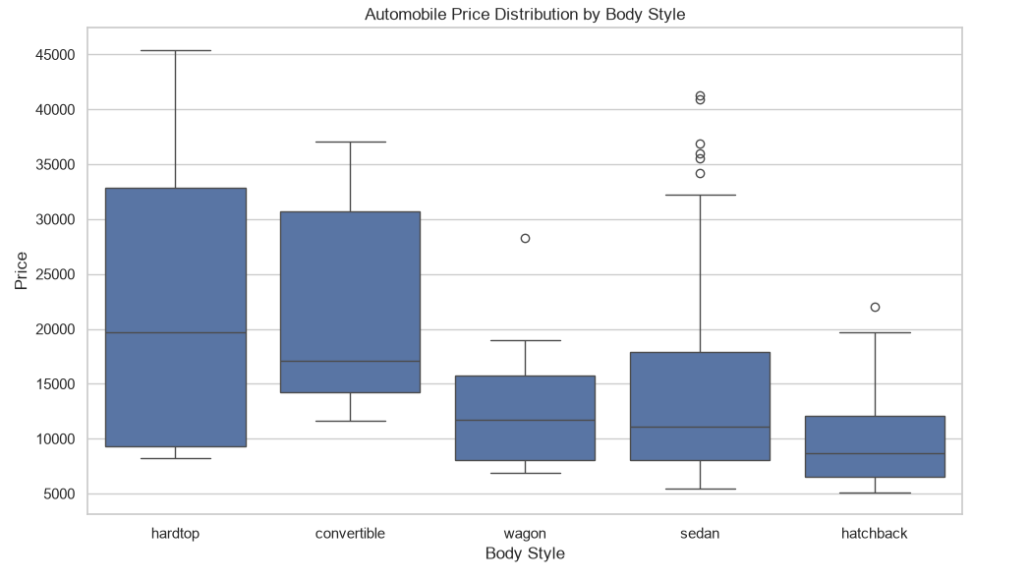
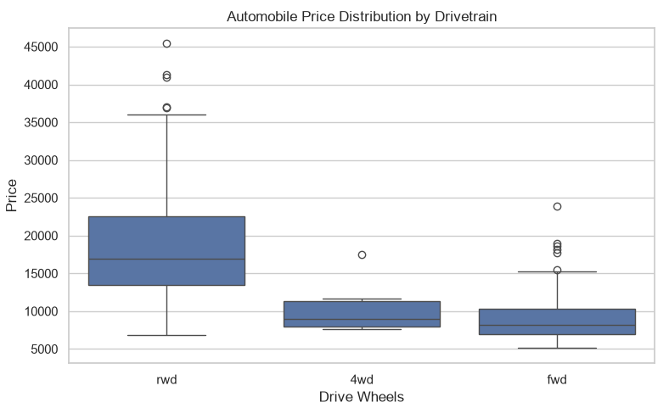
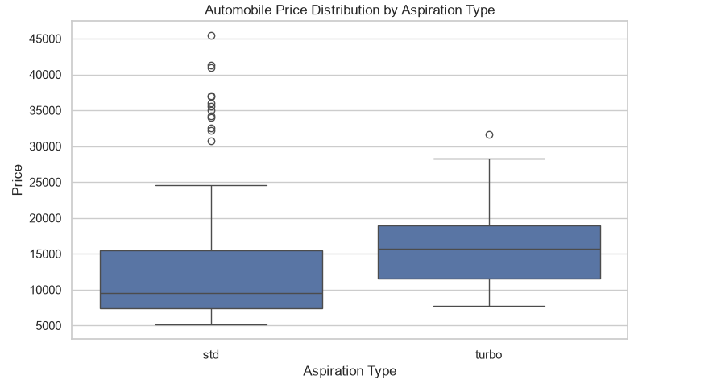
Price distribution by different factors:
1. Convertibles have the highest median price, while hatchbacks have the lowest.
Notes:
1. Convertibles have the highest median price, while hatchbacks have the lowest.
2. Car prices vary by fuel type and other vehicle characteristics.
3. Turbocharged cars have higher median prices than standard cars.
4. RWD cars have the highest median price, but the 4WD sample is small.

Slide 10
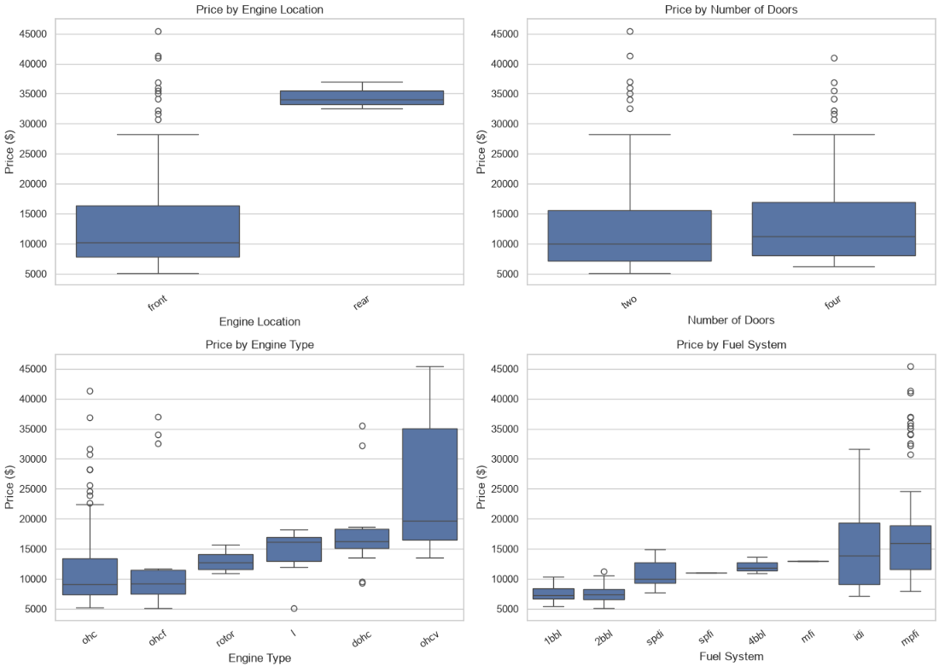
03 • EDA VISUALIZATION
Automobile Prices by Engine and Vehicle Characteristics
Vehicle prices vary across engine and fuel system categories.
Small sample sizes and other factors limit these comparisons.
Engine types:
•ohc (Overhead Camshaft)
•ohcf (Overhead Camshaft Flat)
•rotor (Rotary engine)
•l (L-head / Sidevalve)
•dohc (Double Overhead Camshaft)
•ohcv (Overhead Valve V-engine)
Fuel Systems
•1bbl (Single-barrel carburetor)
•2bbl (Two-barrel carburetor)
•spdi (Stratified Charge Direct Injection)
•spfi (Sequential Single-Point Fuel Injection)
•4bbl (Four-barrel carburetor)
•mfi (Multipoint Fuel Injection)
•idi (Indirect Injection diesel)
•mpfi (Multi-Point Fuel Injection)

Slide 11
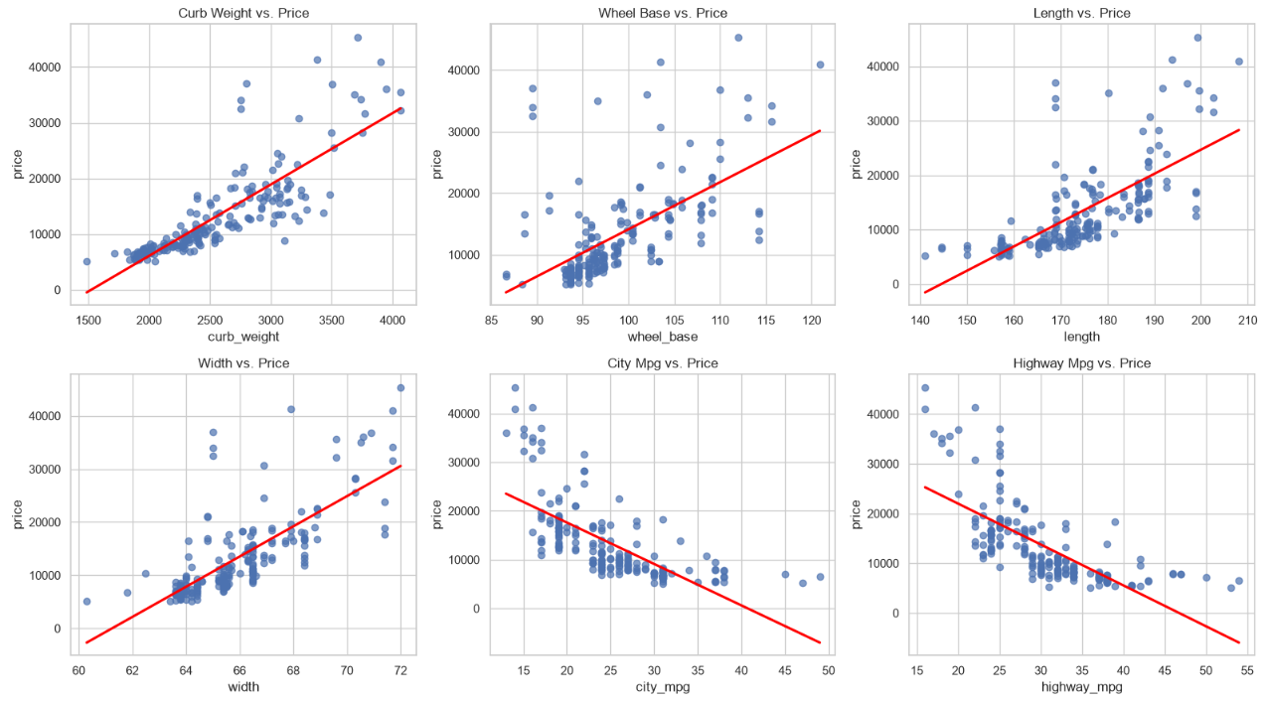
03 • EDA VISUALIZATION
Relationships Between Price and Other Numeric Characteristics
Notes:
Vehicle weight and dimensions have strong positive correlations with price, especially curb weight (r = 0.834).
Fuel economy has a negative relationship with price, meaning higher-MPG cars tend to cost less.
These relationships show association, not causation, and may overlap with other vehicle characteristics.

Slide 12
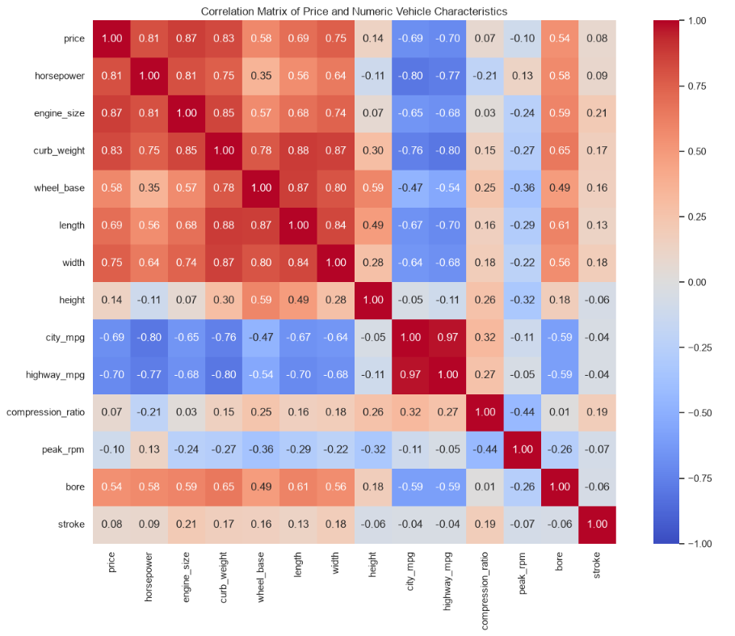
03 • EDA VISUALIZATION
Relationships Among Numeric Predictors
The correlation matrix shows the strength and direction of relationships between vehicle characteristics and price.
Red indicates positive correlation, blue indicates negative correlation, and lighter colors indicate weaker relationships.

Slide 13
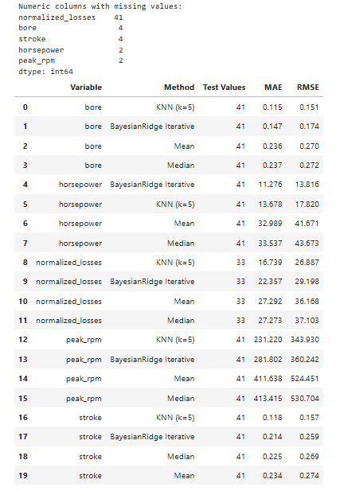
04 • Imputation
Numeric imputation evaluation with a held-out test set
K-Nearest Neighbors (KNN) worked best for most variables, while Bayesian Ridge worked best for horsepower.
No single method worked best for all variables.
Notes:
How: I artificially masked known values, used KNN and BayesianRidge to estimate them, and calculated RMSE by comparing the estimates with the original values. The method with the lower RMSE performed better for that variable. These results are preliminary because we used a single train-test split.”

Slide 14
05 • Findings & Limitations
Conclusion:
1. Engine size had the strongest relationship with car prices (r = 0.872).
2. Weight and horsepower were also strongly related to price.
3. KNN worked best for most missing values, while BayesianRidge worked best for horsepower.
4. The dataset is small and old, so results may not apply to today’s car market.
Limitations:
Old, small dataset: Only 205 cars from the 1980s.
Missing values: Estimates may not match actual values.
Unequal groups: Some categories have very few cars.
Missing factors: Mileage and car condition are unavailable.
14

Slide 15
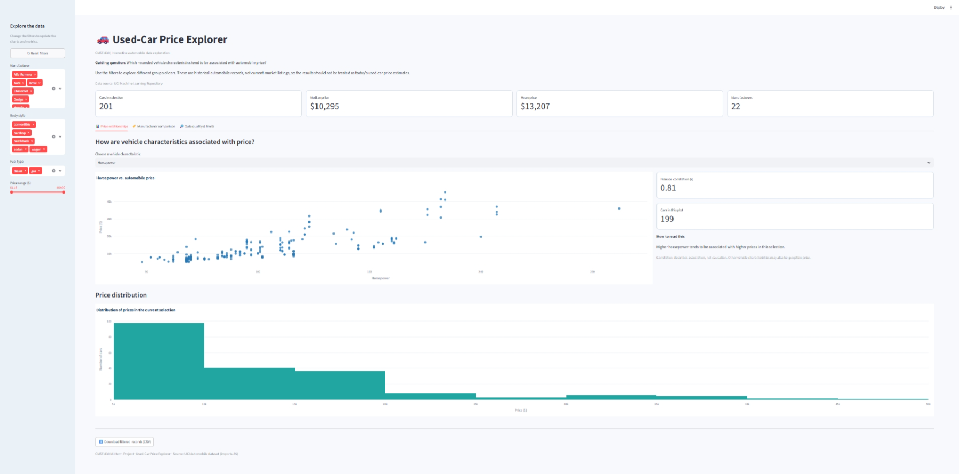
http://localhost:8504/
06 • INTERACTIVE DATA PRODUCT
CMSE 830 • Midterm Project
6

Slide 16
Thank you!
Questions & comments?

